Slide 1




Portfolio Project #3: Cleaning Henderson County Housing Data in SQL Server
Greg Solamon
April 19, 2022 - Emory University

Slide 2


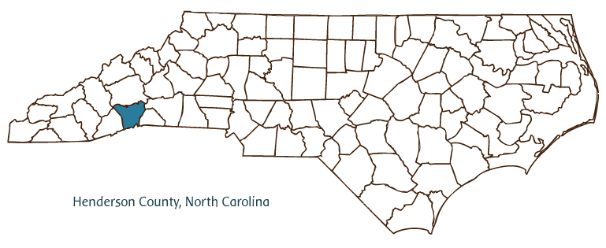
Links
Portfolio Project #3 SQL File (GitHub)
Original Henderson County Housing Dataset (ShareFile)
Final Henderson County Housing Dataset (GitHub)

Slide 3
Original File Issues
Too many irrelevant columns
Duplicate rows
Incorrect data types
Use of DATETIME instead of DATE
Unnecessary single quotes and no use of NULL
Incorrect delimiting in some rows
Split mailing addresses
Missing building numbers and addresses

Slide 4
Original File Issues
Too many irrelevant columns
Duplicate rows
Incorrect data types
Use of DATETIME instead of DATE
Unnecessary single quotes and no use of NULL
Incorrect delimiting in some rows
Split mailing addresses
Missing building numbers and addresses

Slide 5
Too Many Columns
Original table contained over 90 columns (fields) of data.
Not all of these were necessary; some were redundant.
First, I dropped empty fields:
Later, I dropped irrelevant or redundant fields (i.e. alternate keys):
The final table only had 45 fields with the greatest relevance.

Slide 6
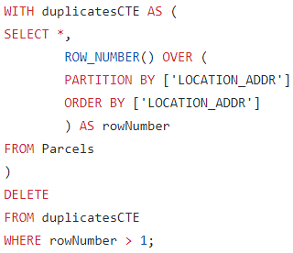
Duplicate Rows for One Parcel (CTE)
Original table sometimes had the same property listed multiple times (because it was bought and sold multiple times).
I used Common Table Expressions (CTE) to remove the extra rows when one piece of land was listed multiple times.

Slide 7
Original File Issues
Too many irrelevant columns
Duplicate rows
Incorrect data types
Use of DATETIME instead of DATE
Unnecessary single quotes and no use of NULL
Incorrect delimiting in some rows
Split mailing addresses
Missing building numbers and addresses

Slide 8
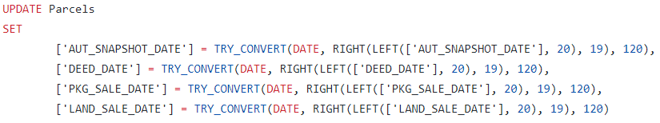
Data Types
Original table was exclusively comprised of STRING (or NVARCHAR) data type, even acreages, dollars, PINs, and keys.
When exploring aggregations, I changed data types using CAST:
All columns referring to a date (e.g. ‘AUT_SNAPSHOT_DATE’) originally attached an unnecessary time of 00:00:00 AM. My fix:

Slide 9
Data Types
Original table was exclusively comprised of STRING (or NVARCHAR) data type, even acreages, dollars, PINs, and keys.
When exploring aggregations, I changed data types using CAST:
All columns referring to a date (e.g. ‘AUT_SNAPSHOT_DATE’) originally attached an unnecessary time of 00:00:00 AM. Fix:
yyyy-mm-dd

Slide 10
Original File Issues
Too many irrelevant columns
Duplicate rows
Incorrect data types
Use of DATETIME instead of DATE
Unnecessary single quotes and no use of NULL
Incorrect delimiting in some rows
Split mailing addresses
Missing building numbers and addresses

Slide 11
Single Quotes and No Use of NULL
Original table wrapped most entries in unnecessary single quotes.
I used LEFT and RIGHT to trim single quotes from STRINGS:
Original table also used empty string ‘’ instead of NULL, which is detrimental to model performance if reports are to be made.
I used a complex dynamic SQL method to replace all empty strings ‘’ with a NULL value.

Slide 12
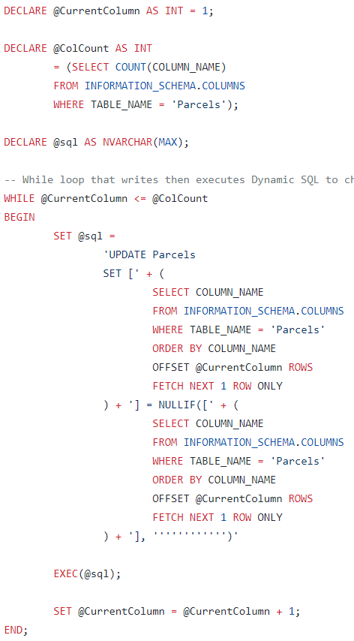
Dynamic SQL
Dynamic SQL uses a programmable method (WHILE loop in this case) to write a STRING of code that is actually an executable SQL.
Here I declare 3 temporary variables, loop through all columns, then all rows, and use NULLIF to set empty strings ‘’ to NULL.
Notice that in SQL the single quote is an escape character, so I actually need 12 quotes to represent ‘’ in the WHILE loop.

Slide 13
Dynamic SQL
Dynamic SQL uses a programmable method (WHILE loop in this case) to write a STRING of code that is actually an executable SQL.
Here I declare 3 temporary variables, loop through all columns, then all rows, and use NULLIF to set empty strings ‘’ to NULL.
Notice that in SQL the single quote is an escape character, so I actually need 12 quotes to represent ‘’ in the WHILE loop.

Slide 14
Original File Issues
Too many irrelevant columns
Duplicate rows
Incorrect data types
Use of DATETIME instead of DATE
Unnecessary single quotes and no use of NULL
Incorrect delimiting in some rows
Split mailing addresses
Missing building numbers and addresses

Slide 15
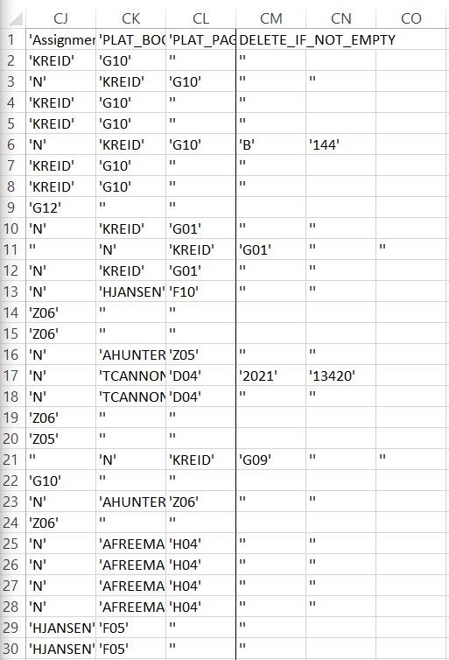
Incorrect Delimiting
1 delimiting error
2 errors
Original file was incorrectly delimited during a previous data entry/file transfer step, which caused some rows to “overflow” past the end of the table.
3 errors

Slide 16
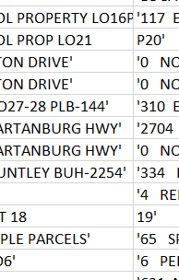
Incorrect Delimiting
Original file was incorrectly delimited during a previous data entry/file transfer step, which caused some rows to “overflow” past the end of the table.
I could see where delimiting errors occurred because single quotes did not appear between two adjacent fields.
Example of delimiting error
No single quotes

Slide 17

Incorrect Delimiting Quick Fix
I devised an arduous fix for this problem using Excel functions, but it would have required filling 90+ temporary columns with over 65,000 rows of data and did not use SQL Server.
This fix was outside the scope of the SQL project, so I gave the overflow column a name ‘DELETE_IF_NOT_EMPTY’ and used SQL Server to exclude overflowing rows from the final table:

Slide 18
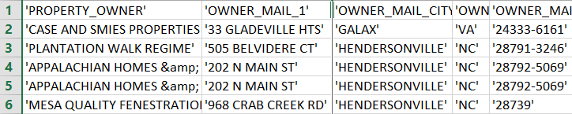
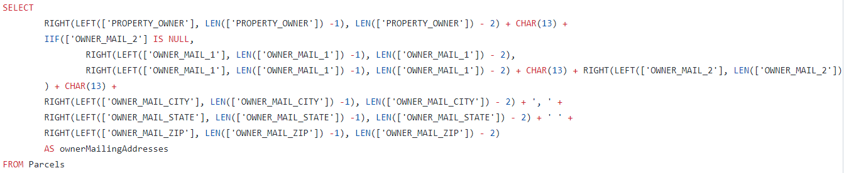
Concatenating Addresses
Owner’s mailing addresses were originally only available in a delimited format:
I used the following SQL to return concatenated addresses (with carriage returns) that could be used to make a mailing list:

Slide 19
Original File Issues
Too many irrelevant columns
Duplicate rows
Incorrect data types
Use of DATETIME instead of DATE
Unnecessary single quotes and no use of NULL
Incorrect delimiting in some rows
Split mailing addresses
Missing building numbers and addresses

Slide 20
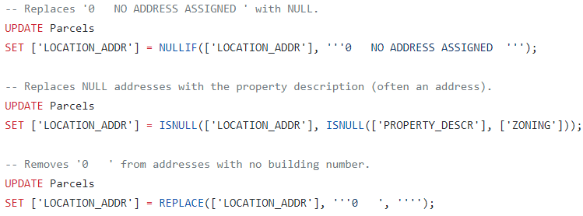
Missing Building Numbers and Addresses
Some building numbers and entire addresses were missing from the original spreadsheet.
I used the following 3 queries to transform the table:
Replaces NULL addresses with property description if available. If not, replaces address with zoning information.

Slide 21
Original File Issues
Too many irrelevant columns
Duplicate rows
Incorrect data types
Use of DATETIME instead of DATE
Unnecessary single quotes and no use of NULL
Incorrect delimiting in some rows
Split mailing addresses
Missing building numbers and addresses

Slide 22
Original File Issues
Questions?
Too many irrelevant columns
Duplicate rows
Incorrect data types
Use of DATETIME instead of DATE
Unnecessary single quotes and no use of NULL
Incorrect delimiting in some rows
Split mailing addresses
Missing building numbers and addresses

